Slide 1


Slide 2
MAIN STAKEHOLDER & ACTORS
City Government
Taxi Company
Clients
Passenger
Taxi Driver
Administrator

Slide 3
MAIN GOALS
Web and Mobile application
Queue fair management
Ride Reservation
Multiple Notifications
Public API
Taxi Sharing

Slide 4
ASSUMPTIONS
Entitled Taxi Drivers
Predetermined City Zones
Taxi Driver manages his own availability
Ride is shared only if is reserved
Shared rides have same pickup and destination zone
All taxis have the same capacity
Requests are turned into Ride after an appropriate time frame

Slide 5
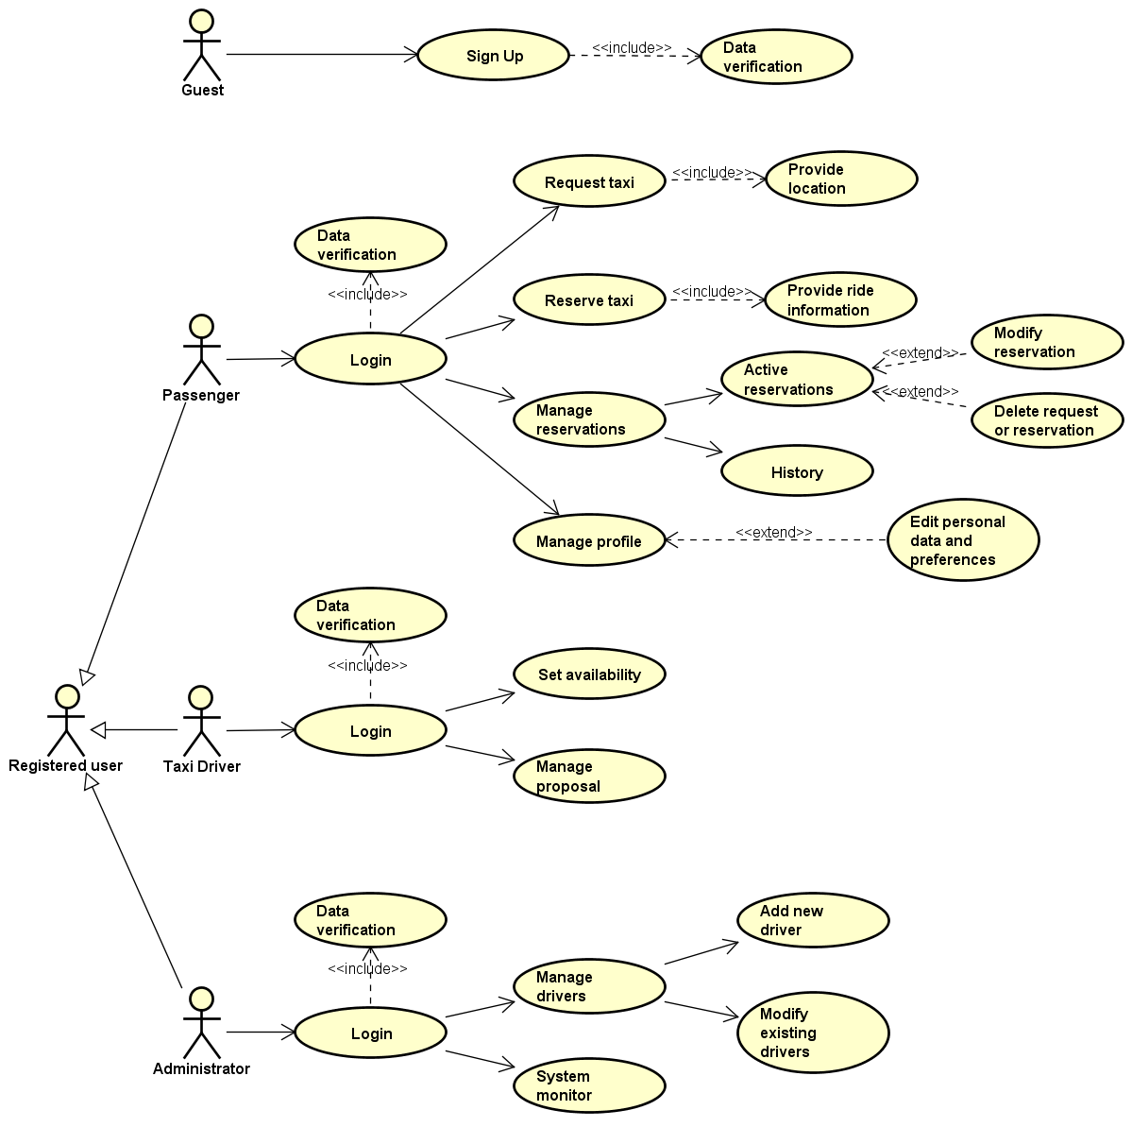
USE CASE

Slide 6
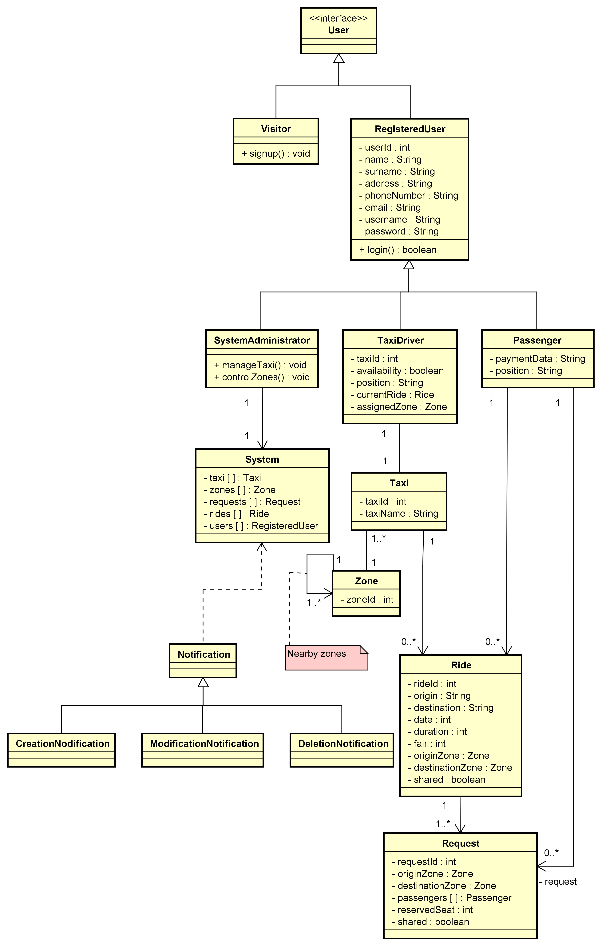
CLASS DIAGRAM

Slide 7
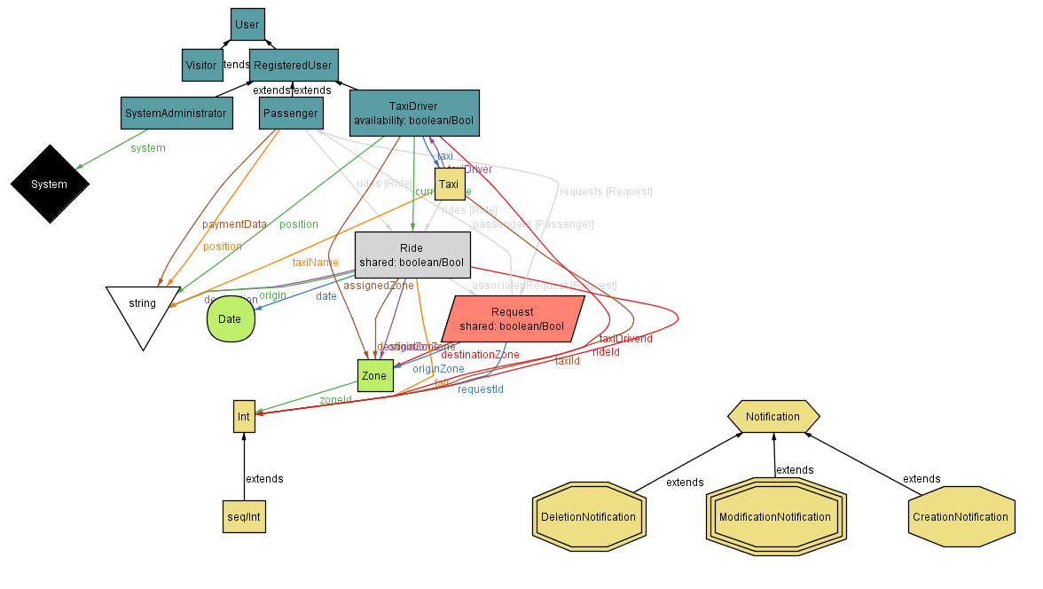
ALLOY

Slide 8
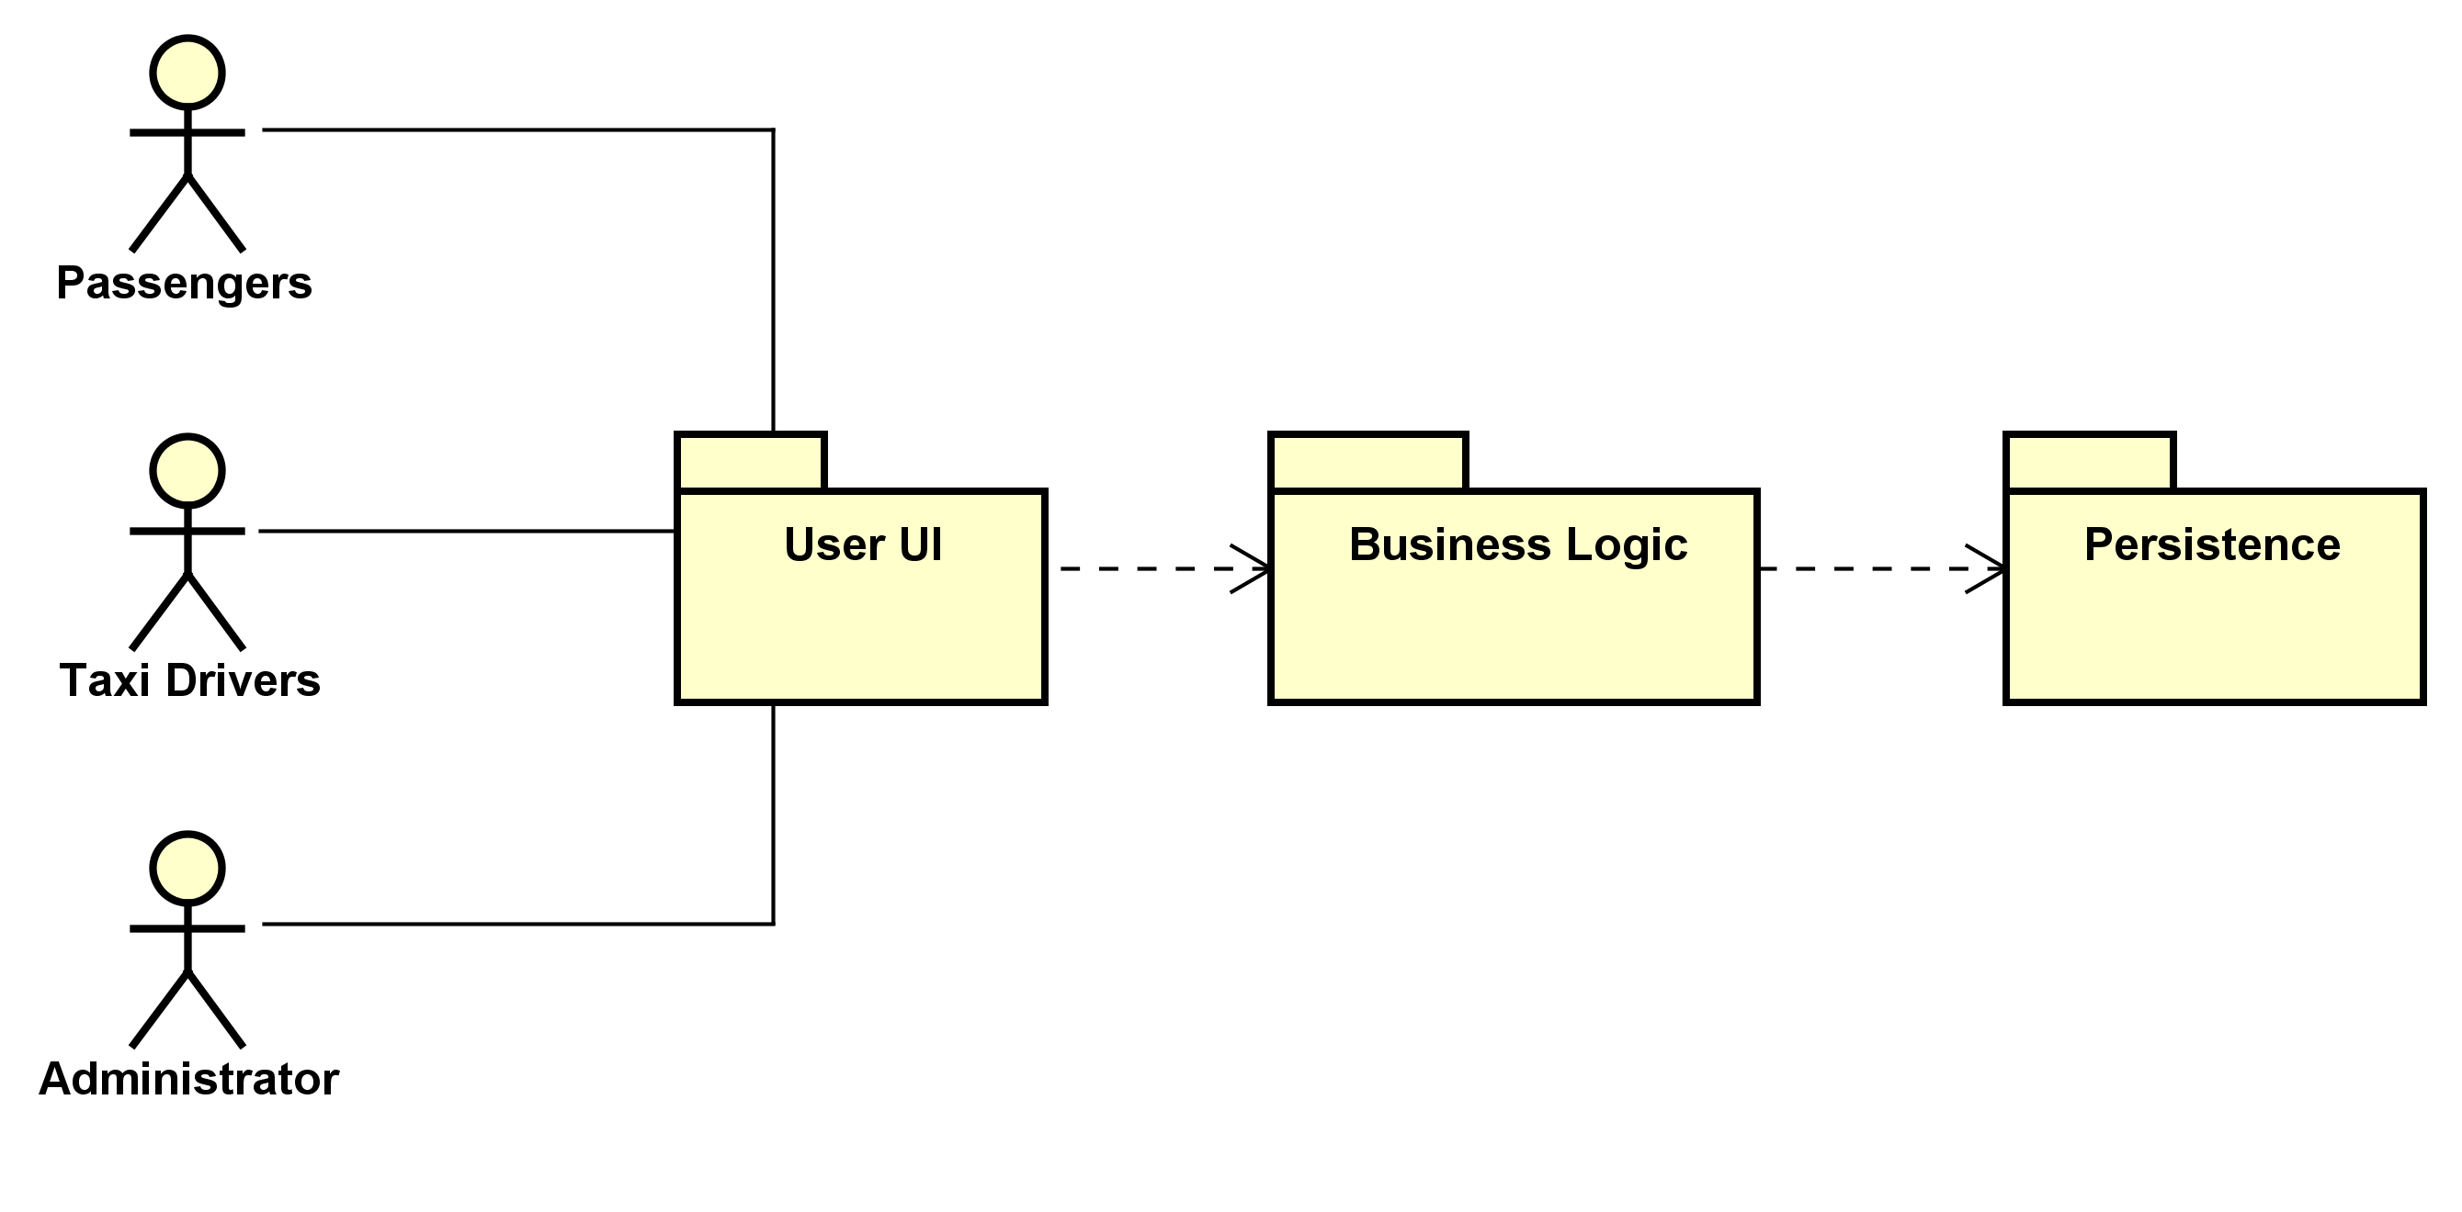
APPLICATION TIERS

Slide 9
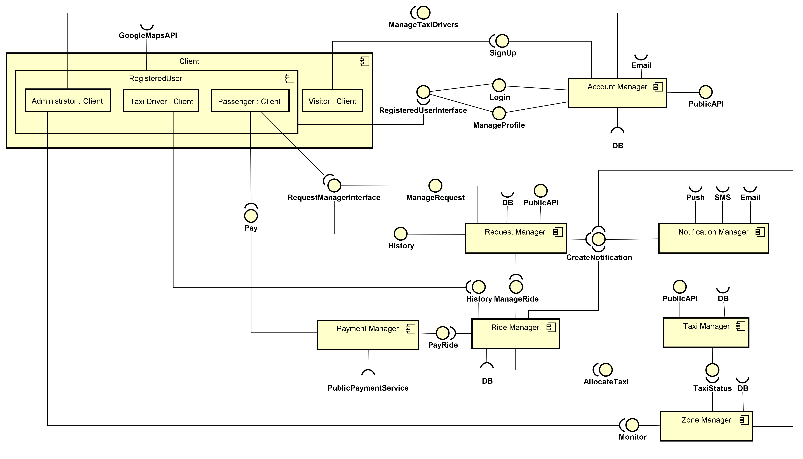
HIGH LEVEL
COMPONENT VIEW

Slide 10
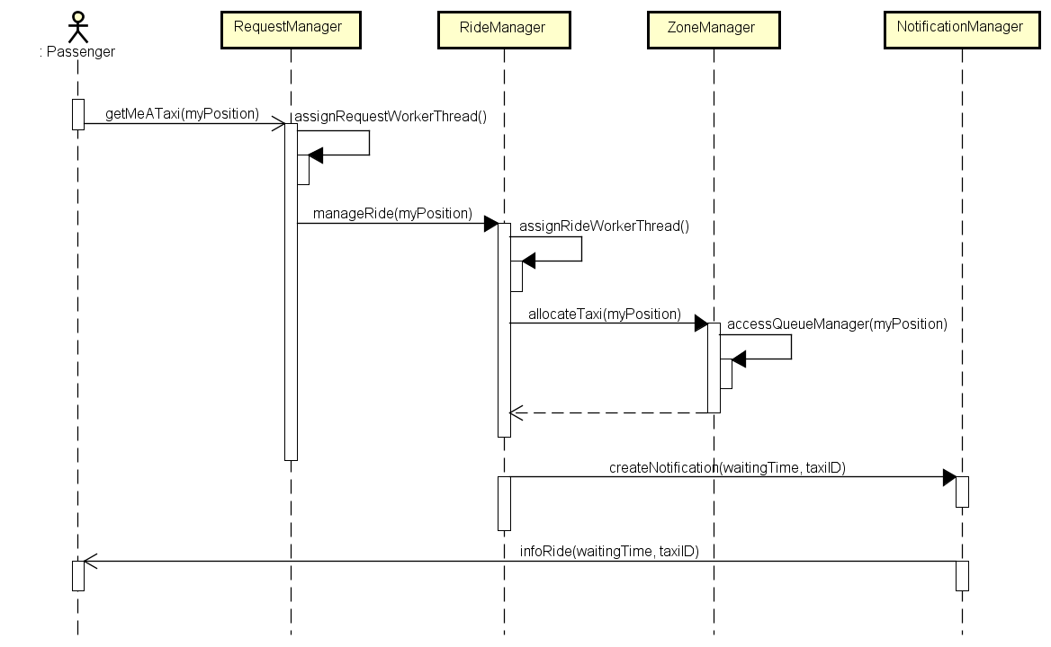
TAXI REQUEST

Slide 11
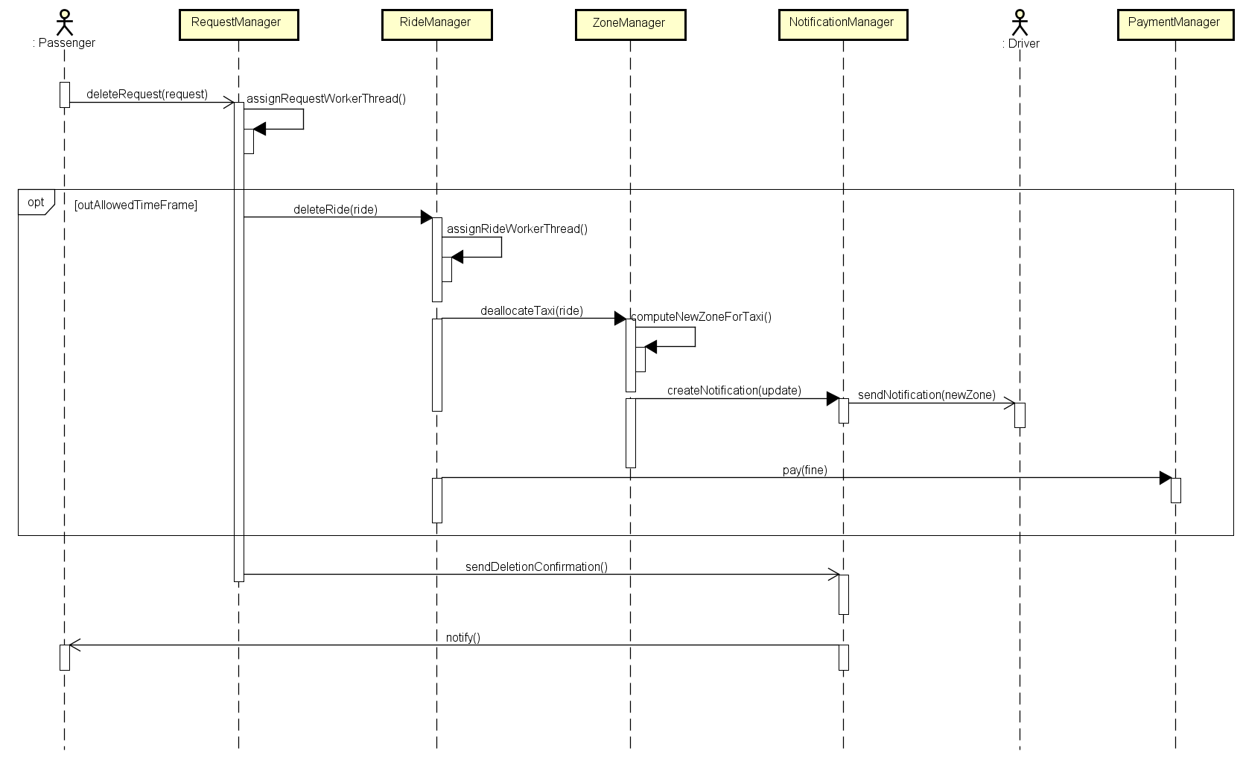
DELETE RESERVATION

Slide 12
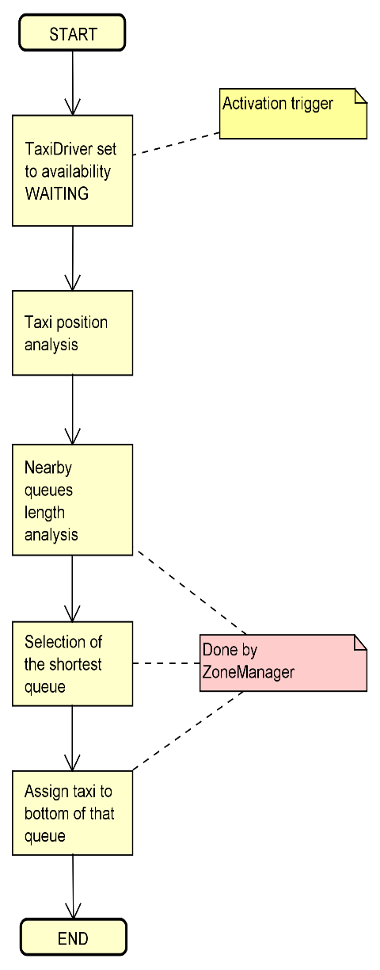
FAIR QUEUE MANAGEMENT

Slide 13
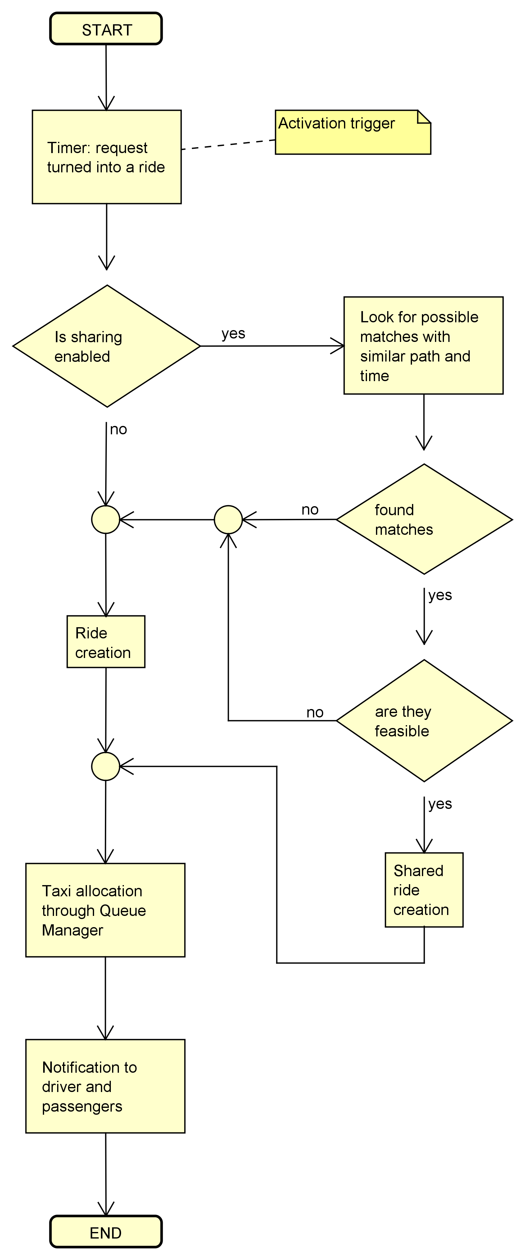
RIDE CREATION

Slide 14
PLACEHOLDER FOR INTEGRATION TEST DOCUMENT

Slide 15
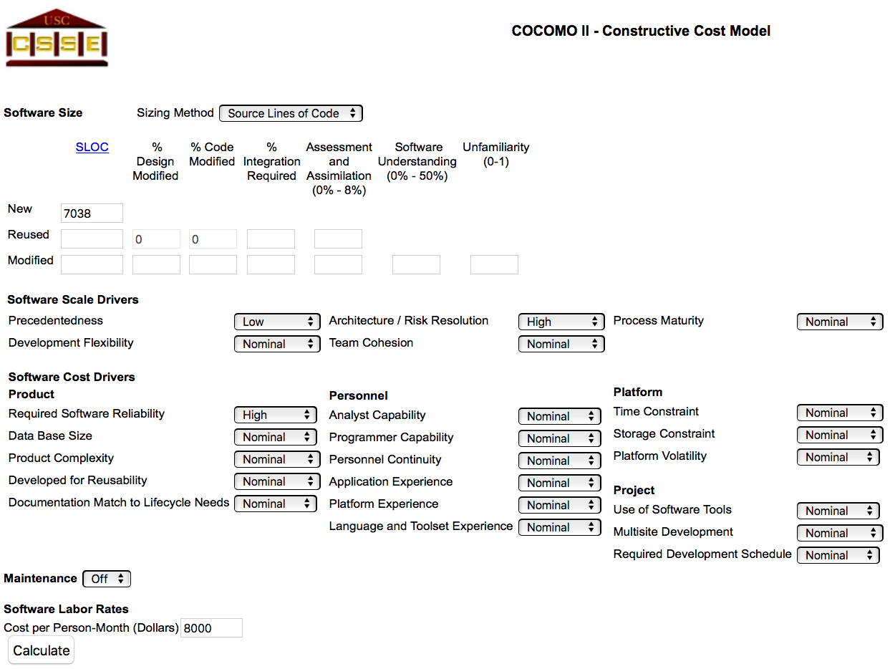
COCOMO II - SETTINGS

Slide 16
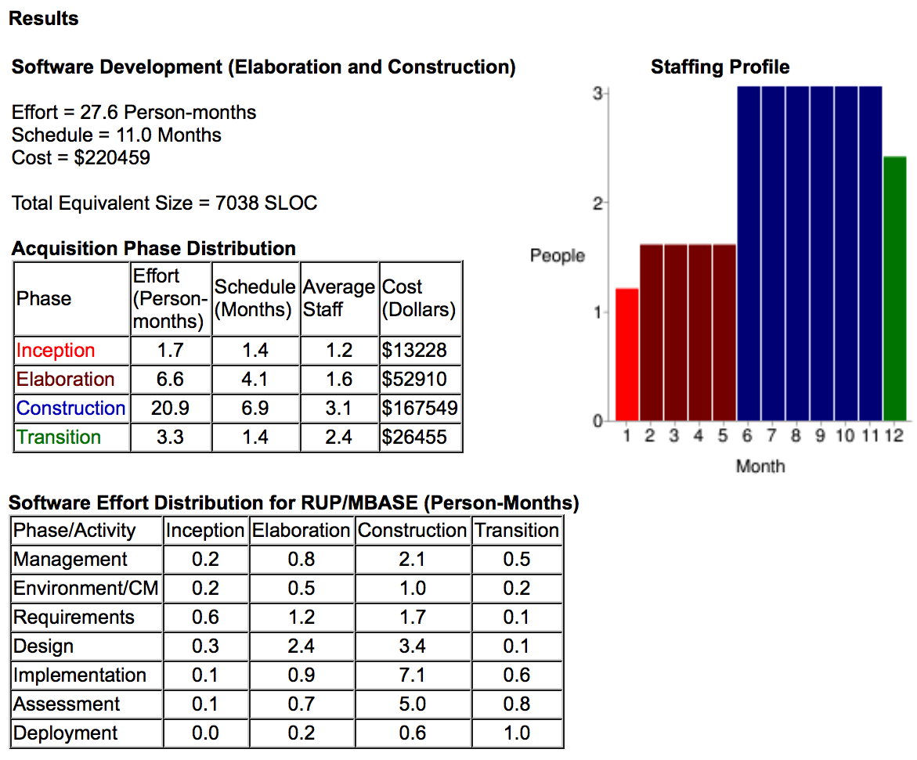
COCOMO II - RESULT

Slide 17
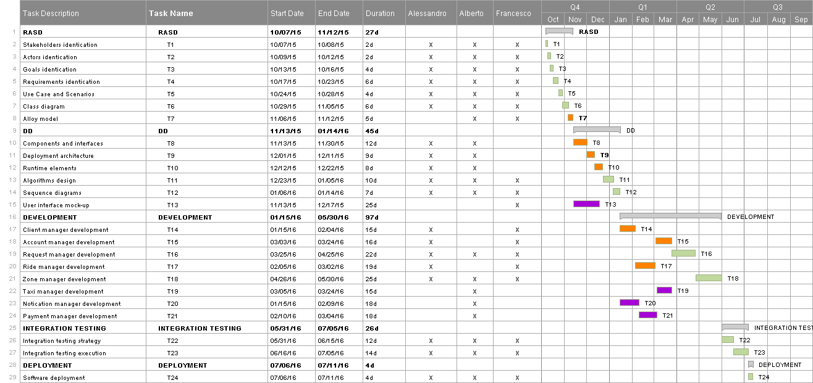
TASK SCHEDULING & RESOURCES ALLOCATION

